Slide 1









Whiteboardmaths.com
7
2
1
5
© 2008 All rights reserved

Slide 2
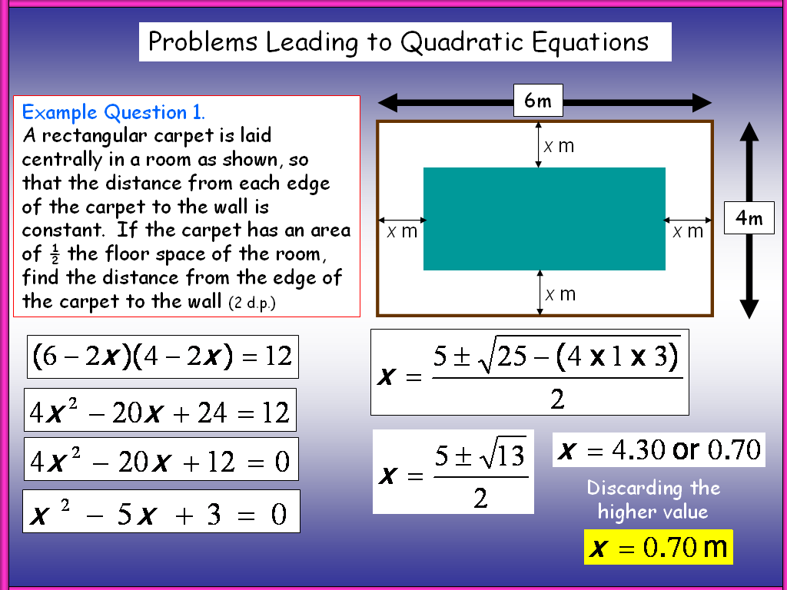
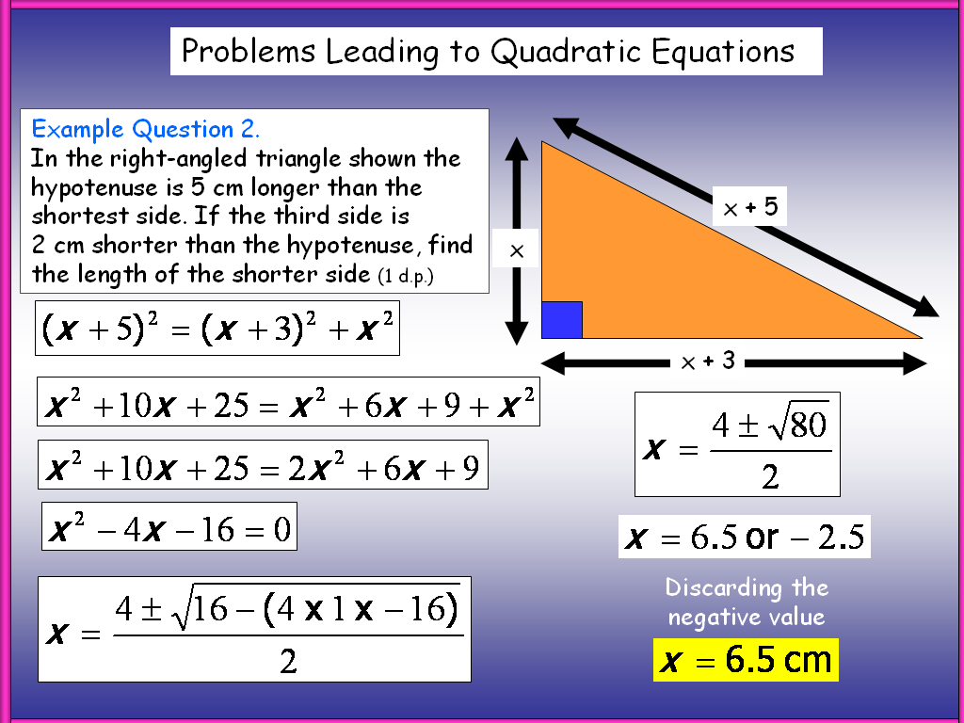
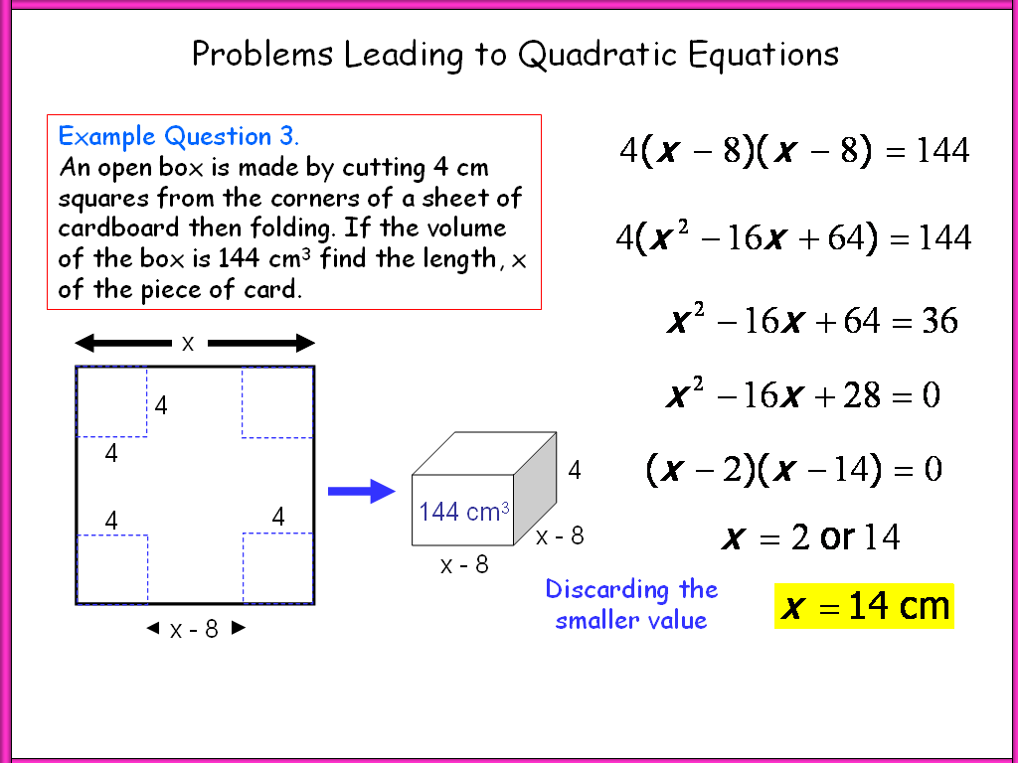
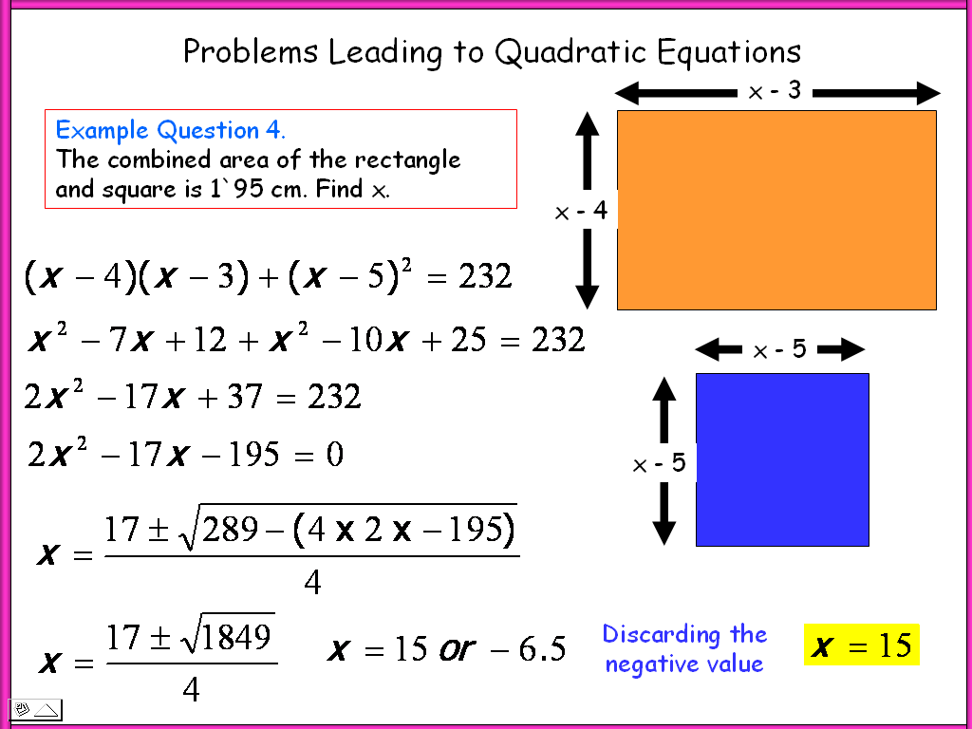
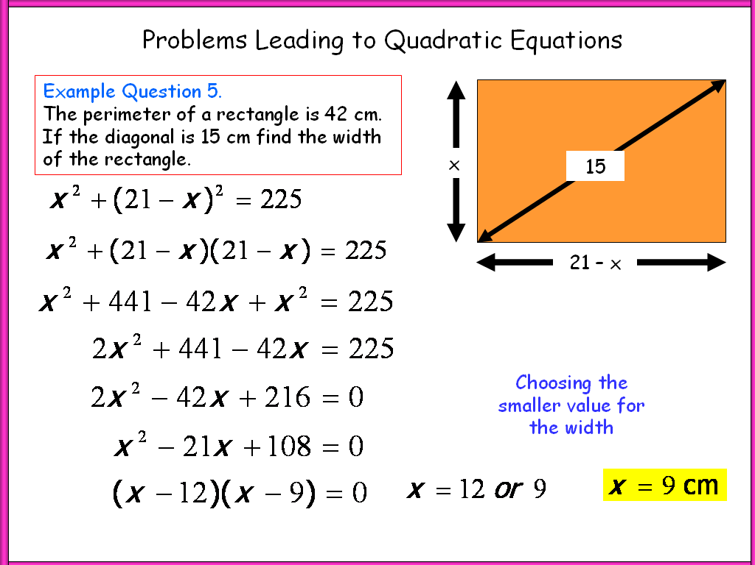
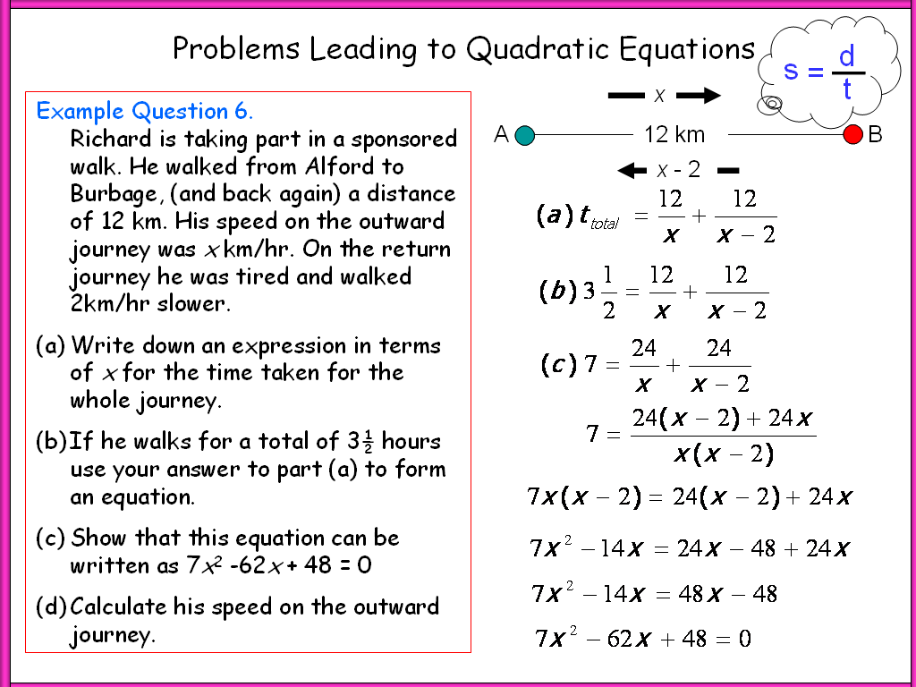
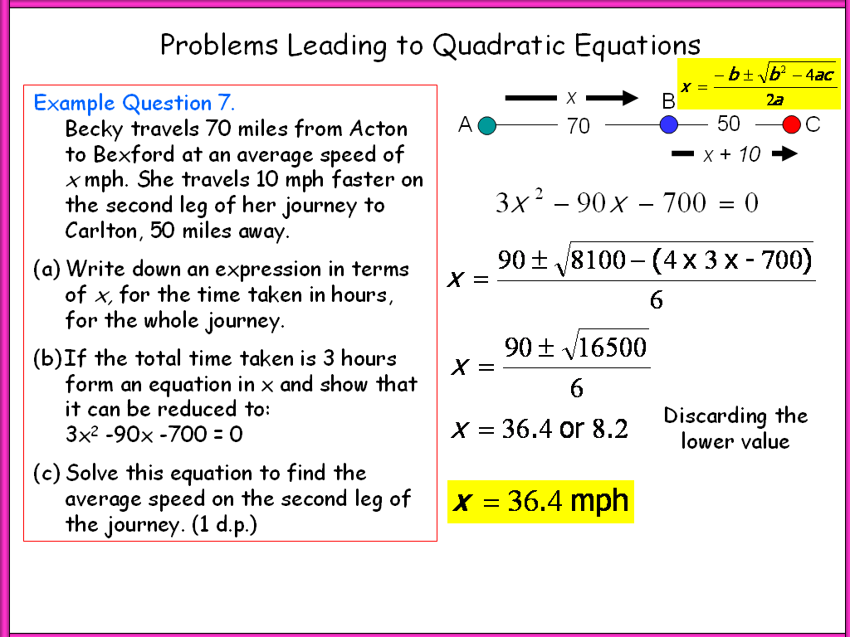
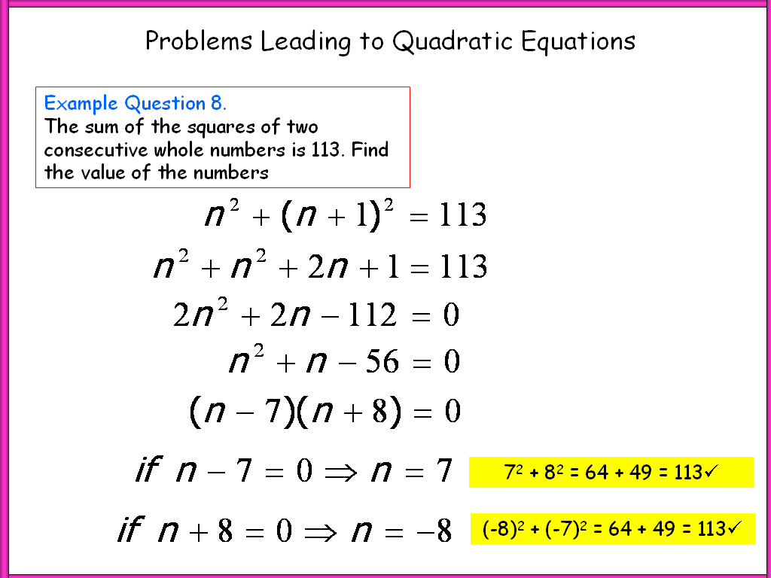
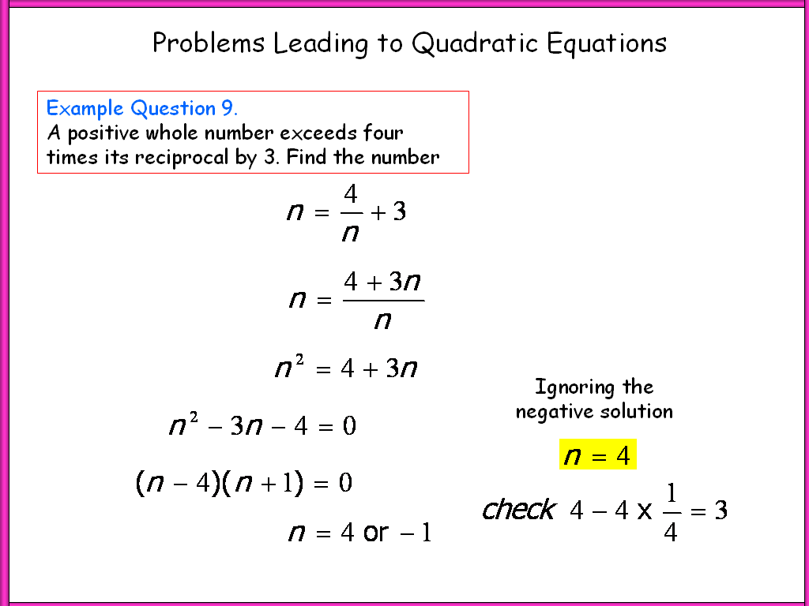
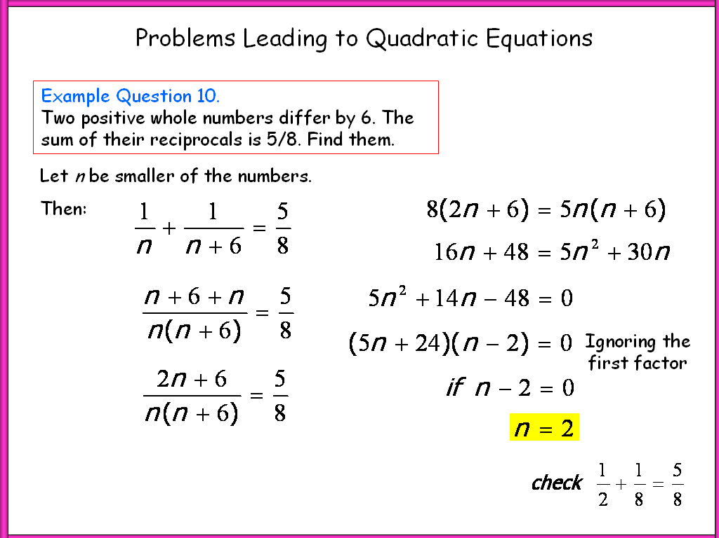
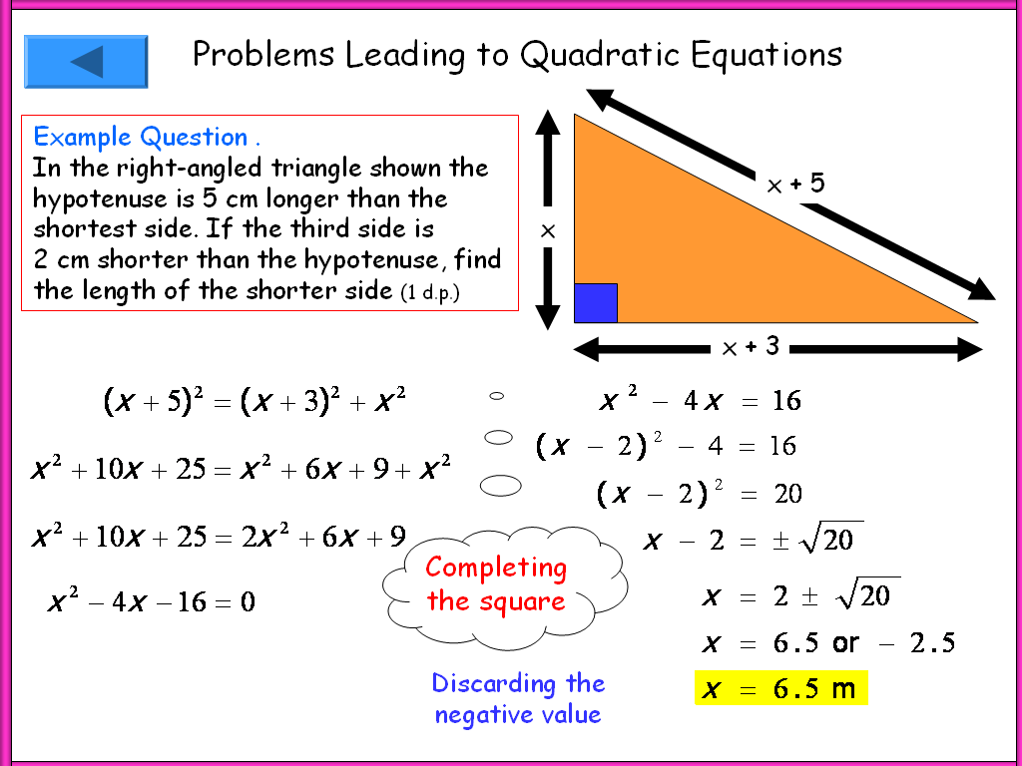
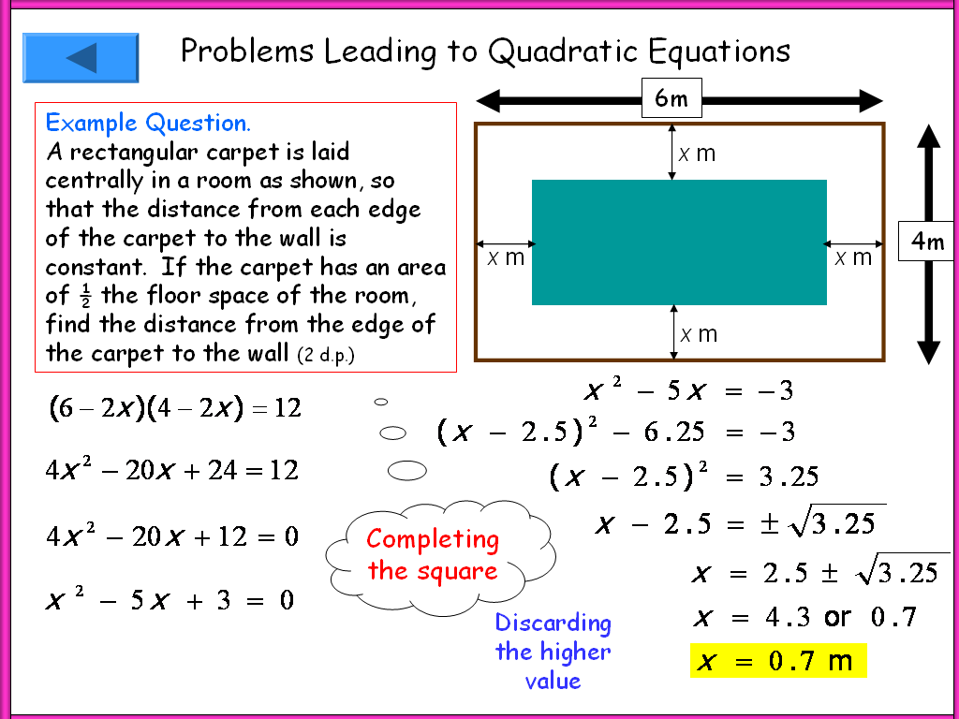
Menu
Quadratic Problem Menu: Click the hyperlink bar below each graphic to visit that problem.
Rectangle: Formula →
Pythagoras: Formula →
Net/Box: Factorise →
Rect/Squ: Formula →
Diagonal: Factorise →
Travel 1: Formula →
Travel 2: Formula →
Numbers 1: Factorise→
Numbers 2: Factorise→
Numbers 3: Factorise→
Complete the Square→
Complete the Square→

Slide 3
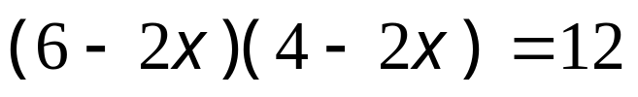
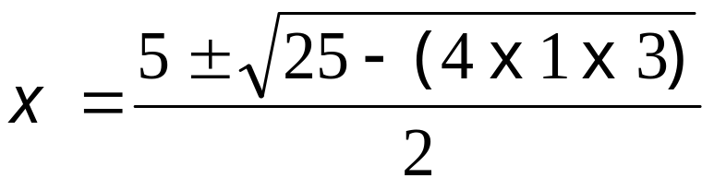
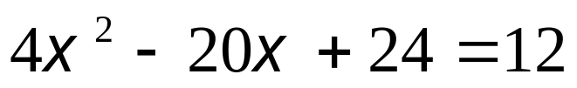
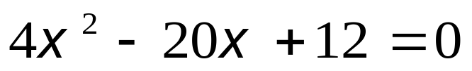
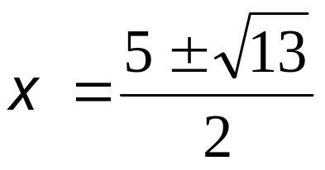

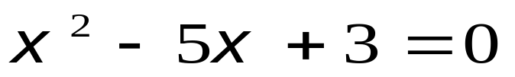

Problems Leading to Quadratic Equations
Example Question. A rectangular carpet is laid centrally in a room as shown, so that the distance from each edge of the carpet to the wall is constant. If the carpet has an area of ½ the floor space of the room, find the distance from the edge of the carpet to the wall (2 d.p.)
6m
x m
4m
x m
x m
x m
Discarding the higher value

Slide 4
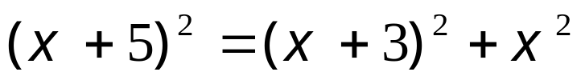
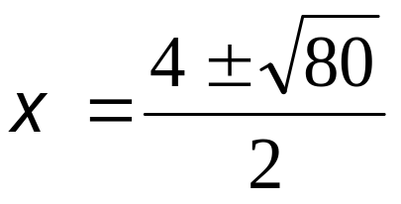



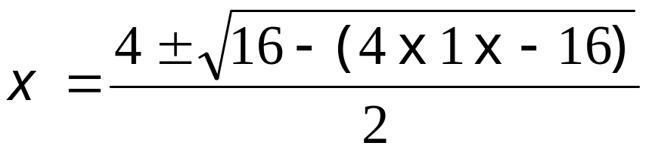

Problems Leading to Quadratic Equations
Example Question . In the right-angled triangle shown the hypotenuse is 5 cm longer than the shortest side. If the third side is 2 cm shorter than the hypotenuse, find the length of the shorter side (1 d.p.)
x + 5
x
x + 3
Discarding the negative value

Slide 5

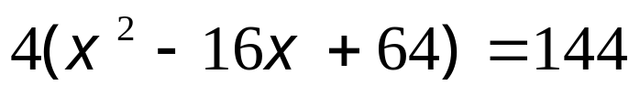





Problems Leading to Quadratic Equations
Example Question. An open-top box is made by cutting 4 cm squares from the corners of a sheet of cardboard then folding. If the volume of the box is 144 cm³ find the length, x of the piece of card.
x
4
4
4
4
4
144 cm³
x - 8
x - 8
Discarding the smaller value
x - 8

Slide 6
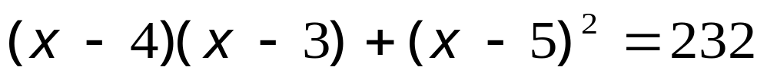


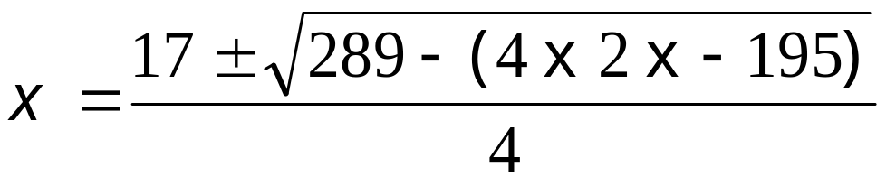

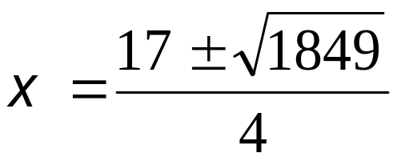

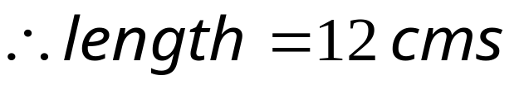
Problems Leading to Quadratic Equations
x - 3
Example Question. The combined area of the rectangle and square is 232 cm². Find the length of the rectangle.
x - 4
x - 5
x - 5
Discarding the negative value

Slide 7
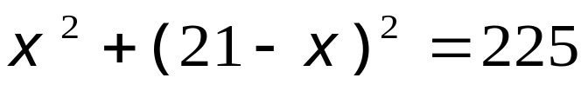
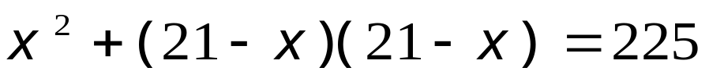
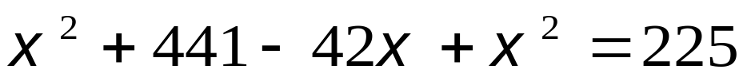
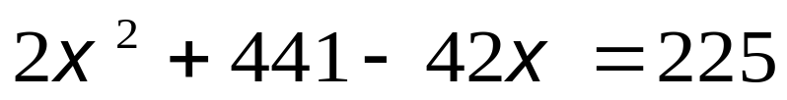
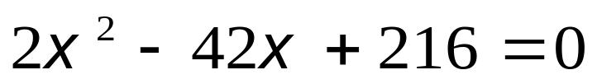
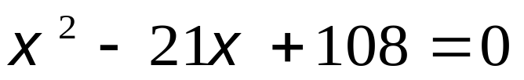
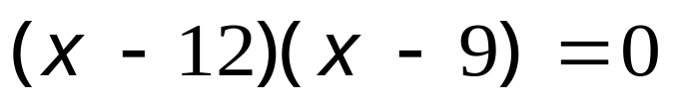


Problems Leading to Quadratic Equations
Example Question. The perimeter of a rectangle is 42 cm. If the diagonal is 15 cm find the width of the rectangle.
15
x
21 – x
Choosing the smaller value for the width

Slide 8
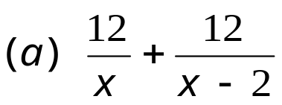
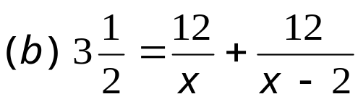
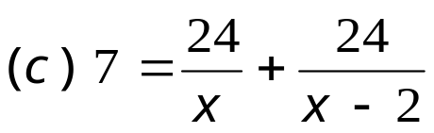
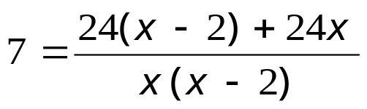




Problems Leading to Quadratic Equations
d
s
=
x
t
Example Question. Richard is taking part in a sponsored walk. He walked from Alford to Burbage, (and back again) a distance of 12 km. His speed on the outward journey was x km/hr. On the return journey he was tired and walked 2km/hr slower.
Write down an expression in terms of x for the time taken for the whole journey.
If he walks for a total of 3½ hours use your answer to part (a) to form an equation.
Show that this equation can be written as 7x² - 62x + 48 = 0
Calculate his speed on the outward journey.
A
12 km
B
x - 2
Part (d)→

Slide 9
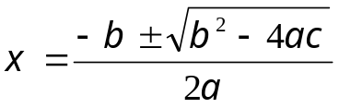

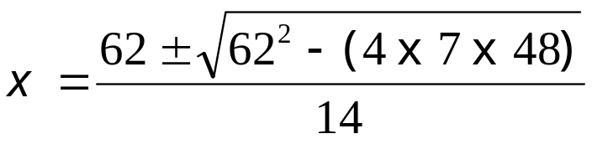
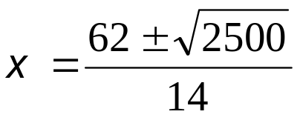


Problems Leading to Quadratic Equations
x
Example Question. Richard is taking part in a sponsored walk. He walked from Alford to Burbage, (and back again) a distance of 12 km. His speed on the outward journey was x km/hr. On the return journey he was tired and walked 2km/hr slower.
Write down an expression in terms of x for the time taken for the whole journey.
If he walks for a total of 3½ hours use your answer to part (a) to form an equation.
Show that this equation can be written as 7x² - 62x + 48 = 0
Calculate his speed on the outward journey.
A
12 km
B
x - 2
Discarding the smaller value

Slide 10
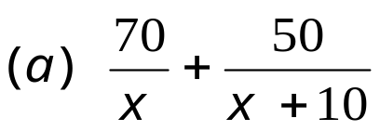
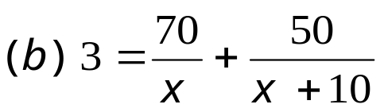
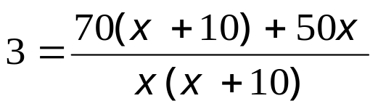


Problems Leading to Quadratic Equations
d
s
=
t
Example Question. Becky travels 70 miles from Acton to Bexford at an average speed of x mph. She travels 10 mph faster on the second leg of her journey to Carlton, a further 50 miles away.
Write down an expression in terms of x, for the time taken in hours, for the whole journey.
If the total time taken is 3 hours form an equation in x and show that it can be reduced to: 3x² - 90x -700 = 0
Solve this equation to find the average speed on the second leg of the journey. (1 d.p.)
x
B
A
70
50
C
x + 10
Part (d)→

Slide 11
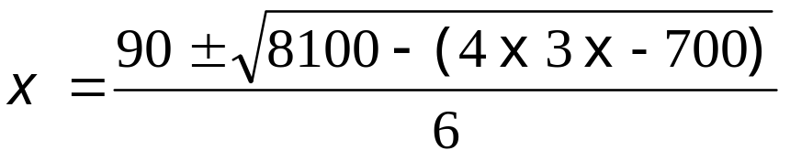
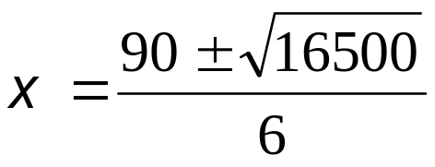


Problems Leading to Quadratic Equations
Example Question. Becky travels 70 miles from Acton to Bexford at an average speed of x mph. She travels 10 mph faster on the second leg of her journey to Carlton, a further 50 miles away.
Write down an expression in terms of x, for the time taken in hours, for the whole journey.
If the total time taken is 3 hours form an equation in x and show that it can be reduced to: 3x² - 90x -700 = 0
Solve this equation to find the average speed on the second leg of the journey. (1 d.p.)
x
B
A
70
50
C
x + 10
Discarding the negative value

Slide 12
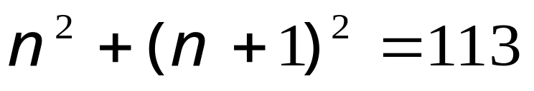
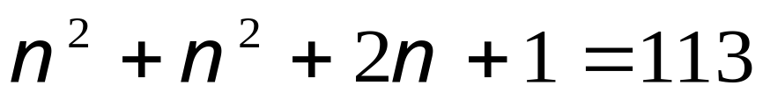
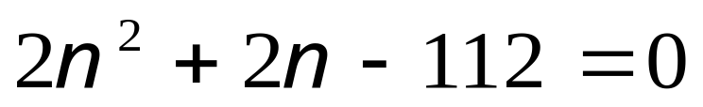
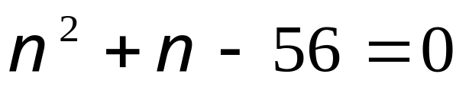
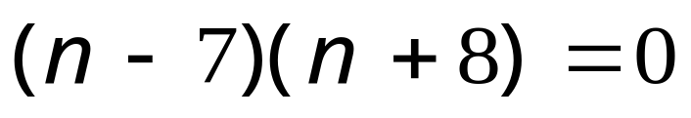


Problems Leading to Quadratic Equations
Example Question. The sum of the squares of two consecutive whole numbers is 113. Find the numbers.
7² + 8² = 64 + 49 = 113✓
(-8)² + (-7)² = 64 + 49 = 113✓

Slide 13








Problems Leading to Quadratic Equations
Example Question. A positive whole number exceeds four times its reciprocal by 3. Find the number.
Ignoring the negative solution

Slide 14










Problems Leading to Quadratic Equations
Example Question. Two positive whole numbers differ by 6. The sum of their reciprocals is 5/8. Find them.
Let n be smaller of the numbers.
Then:
Ignoring the first factor

Slide 15







Problems Leading to Quadratic Equations
Example Question . In the right-angled triangle shown the hypotenuse is 5 cm longer than the shortest side. If the third side is 2 cm shorter than the hypotenuse, find the length of the shorter side (1 d.p.)
x + 5
x
x + 3
Completing the square
Discarding the negative value

Slide 16







Problems Leading to Quadratic Equations
6m
Example Question. A rectangular carpet is laid centrally in a room as shown, so that the distance from each edge of the carpet to the wall is constant. If the carpet has an area of ½ the floor space of the room, find the distance from the edge of the carpet to the wall (2 d.p.)
x m
4m
x m
x m
x m
Completing the square
Discarding the higher value

Slide 17
Worksheets
1. A rectangular carpet is laid centrally in a room as shown, so that the distance from each edge of the carpet to the wall is constant. If the carpet has an area of ½ the floor space of the room, find the distance from the edge of the carpet to the wall (2 d.p.)
6 m
4 m
2. In the right-angled triangle shown the hypotenuse is 5 cm longer than the shortest side. If the third side is 2 cm shorter than the hypotenuse, find the length of the shorter side (1 d.p.)
3. An open-box is made by cutting 4 cm squares from the corners of a sheet of cardboard then folding. If the volume of the box is 144 cm³ find the length, x of the piece of card.
4
4
4
144 cm³
4

Slide 18
4. The combined area of the rectangle and square is 232² cm. Find the length of the rectangle.
x - 3
x - 5
x - 4
x - 5
5. The perimeter of a rectangle is 42 cm. If the diagonal is 15 cm find the width of the rectangle.
15

Slide 19
6. Richard is taking part in a sponsored walk. He walked from Alford to Burbage, (and back again) a distance of 12 km. His speed on the outward journey was x km/hr. On the return journey he was tired and walked 2km/hr slower.
Write down an expression in terms of x for the time taken for the whole journey.
If he walks for a total of 3½ hours use your answer to part (a) to form an equation.
Show that this equation can be written as 7x² -62x + 48 = 0
Calculate his speed on the outward journey.
7. Becky travels 70 miles from Acton to Bexford at an average speed of x mph. She travels 10 mph faster on the second leg of her journey to Carlton, 50 miles away.
Write down an expression in terms of x, for the time taken in hours, for the whole journey.
If the total time taken is 3 hours form an equation in x and show that it can be reduced to: 3x² -90x -700 = 0
Solve this equation to find the average speed on the second leg of the journey. (1 d.p.)

Slide 20
8. The sum of the squares of two consecutive whole numbers is 113. Find the numbers
9. A positive whole number exceeds four times its reciprocal by 3. Find the number
10. Two positive whole numbers differ by 6. The sum of their reciprocals is 5/8. Find them.

Slide 21
Worksheet (completing the square)
11. In the right-angled triangle shown the hypotenuse is 5 cm longer than the shortest side. If the third side is 2 cm shorter than the hypotenuse, find the length of the shorter side (1 d.p.)
12. A rectangular carpet is laid centrally in a room as shown, so that the distance from each edge of the carpet to the wall is constant. If the carpet has an area of ½ the floor space of the room, find the distance from the edge of the carpet to the wall (2 d.p.)
6 m
4 m

